Slide 1
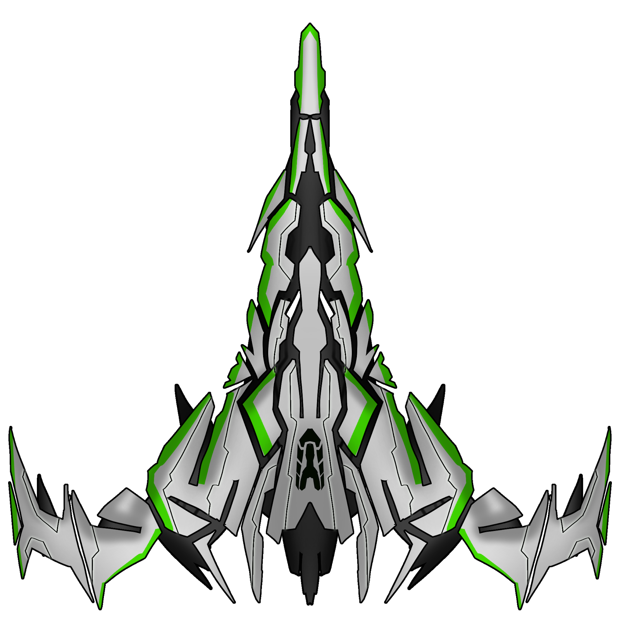
Ship Design
Core Attributes:
Weapon bays
Shields
Active protection, requires working capacitor, recharge rate, no risk of damage while they can still absorb damage
Hull
Passive protection, the last line of defense, increased damage will risk subsystem damage
Capacitor
Engines
Special Attributes:
Redundancy protection
May spend points to bolster protection of specific subsystems. Doing so reduces likelihood of damage by points spent / 10.
Derived Attributes:
Signature

Slide 2
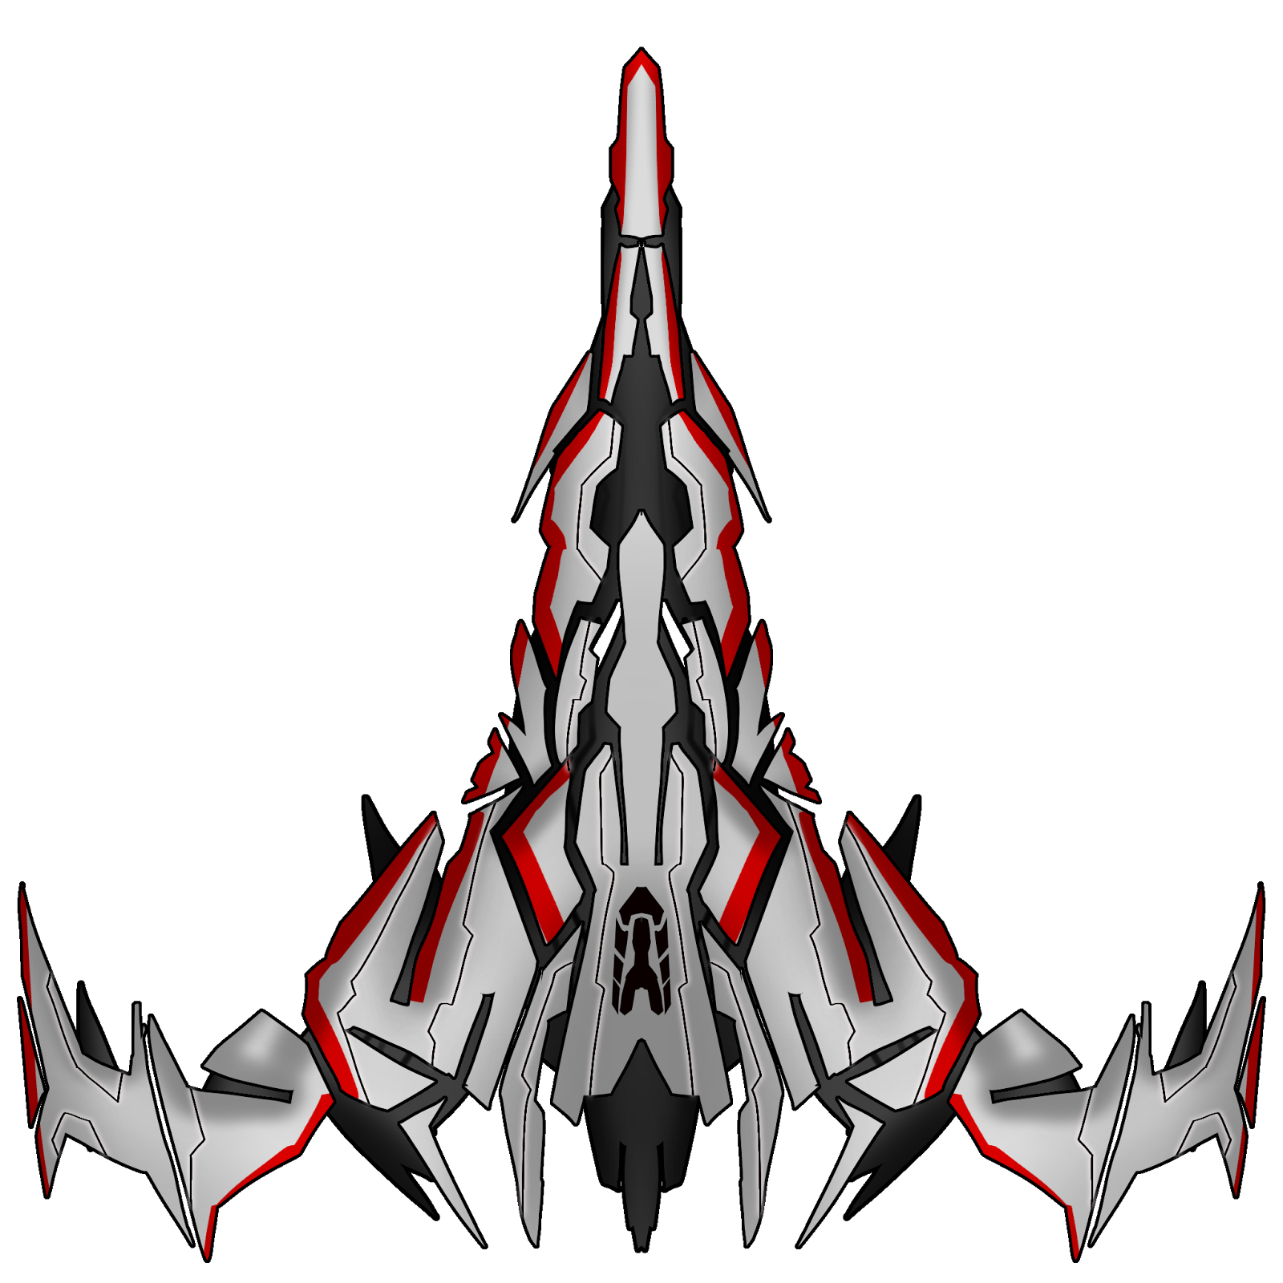
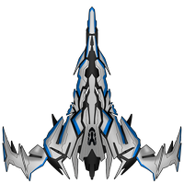
Ship Combat: Attacking
1st attack:
Defender hull strength: 10
Effective attack power: 3
Targeted subsystem: engines
Result:
Defender’s hull strength drops to 7, so the chance of damaging the targeted subsystem is low. Defenders engines are safe for the moment.
2nd attack:
Defender hull strength: 7
Effective attack power: 2
Targeted subsystem: engines
Result:
Defender’s hull strength drops below 6, and his engines are not protected by redundancies. 50% chance of reducing defender’s mobility by half.

